Slide 1
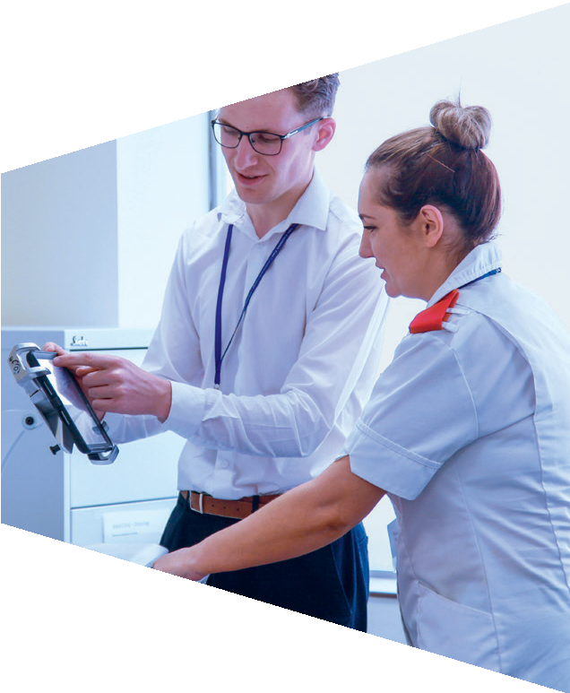
Topic 2: Work-related skills

Slide 2
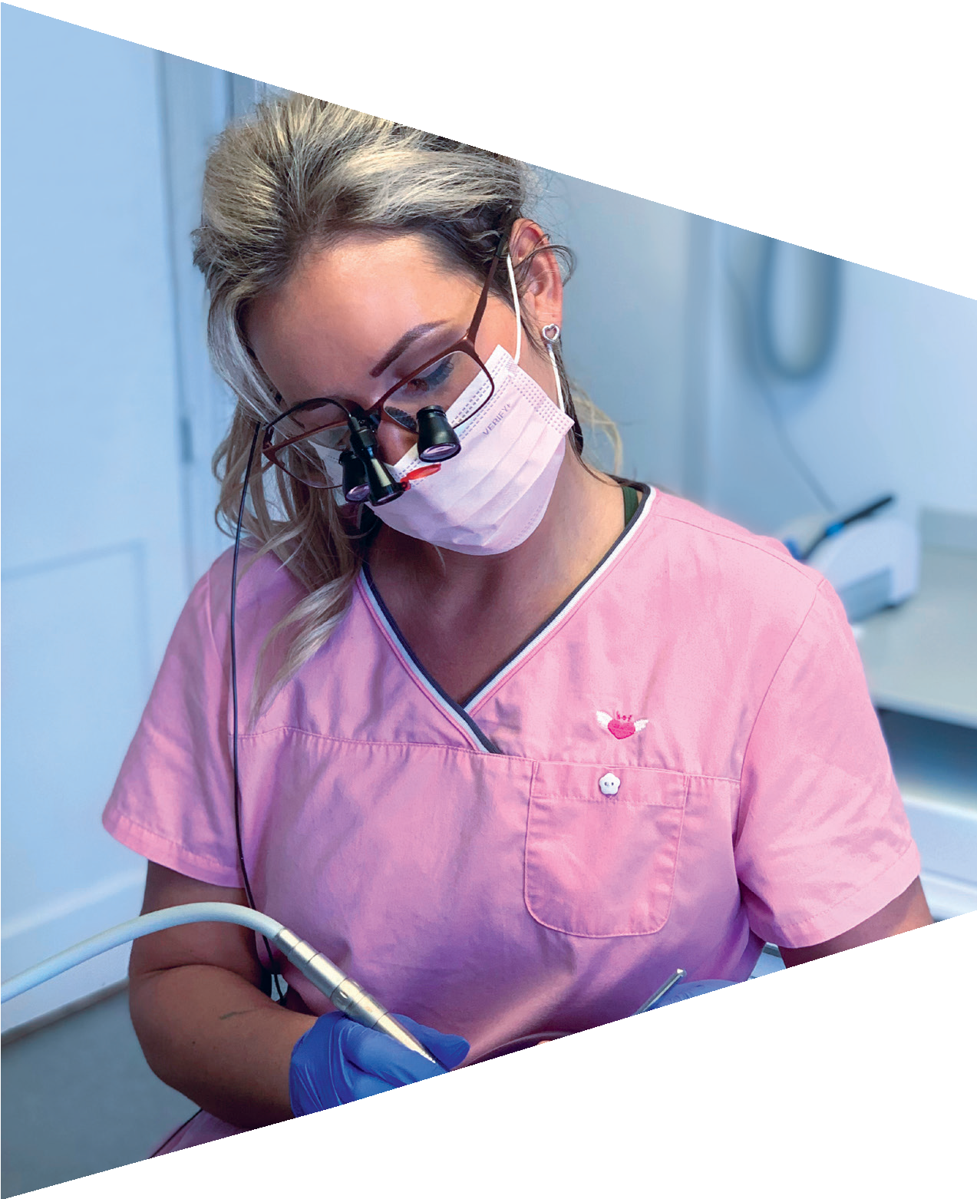
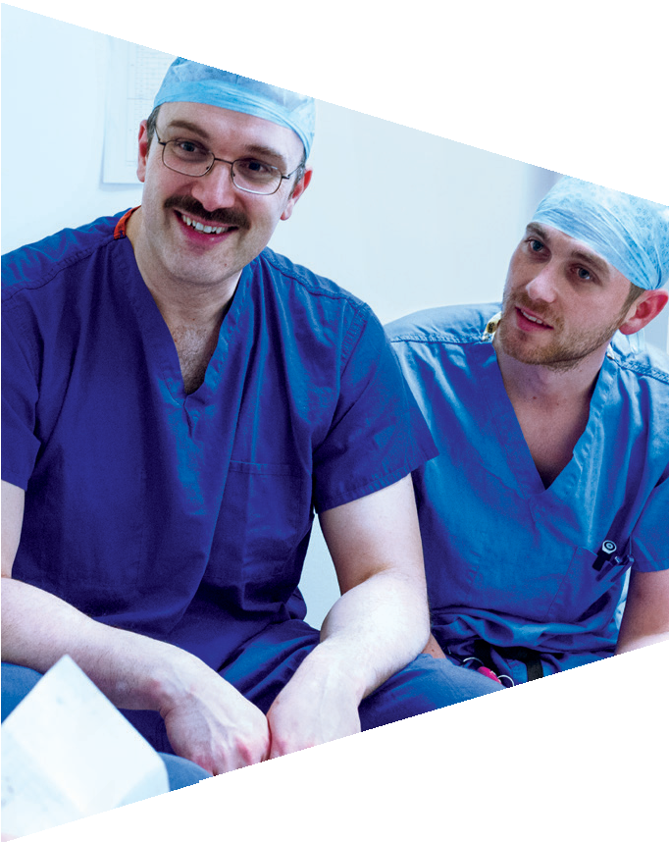
Activity 1: Work-related skills

Slide 3
Diamond 9
You are going to be shown images of different jobs.
Working in pairs, you need to organise your nine skill cards into a diamond.
The most important skill for the job should be at the top point, and the least important should be at the bottom point.
Once you have completed this, discuss and agree the ranking with another pair.

Slide 4
Diamond 9
1
2
2
3
3
3
4
4
5

Slide 5
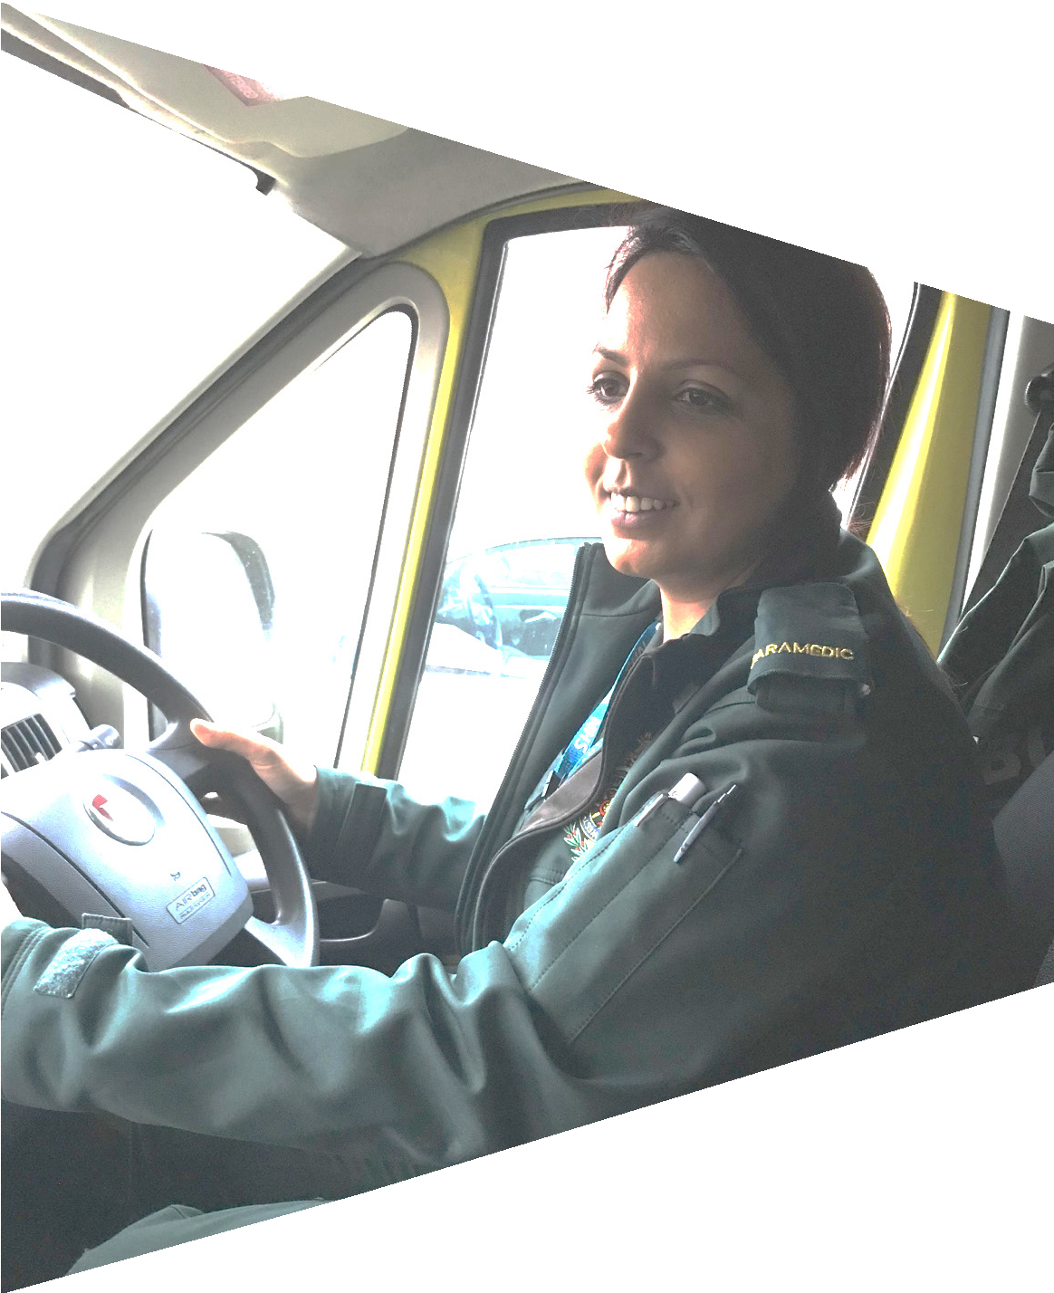
Paramedic
Paramedics are the senior members of accident and emergency ambulance crews, trained in all aspects of pre-hospital emergency care and in emergency driving.

Slide 6
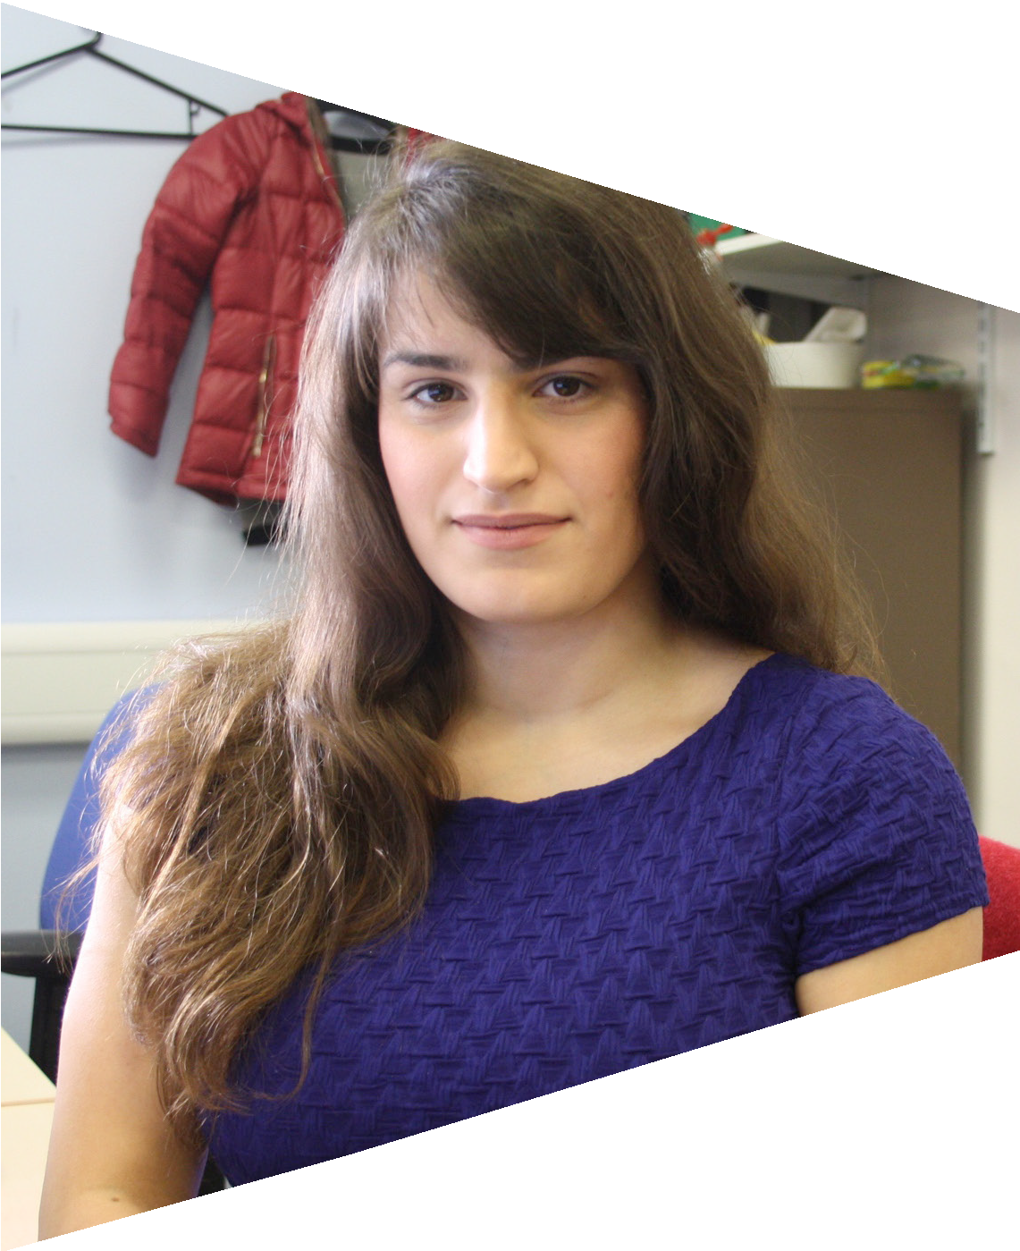
Finance manager
Finance managers are responsible for ensuring that NHS funds
are appropriately allocated and accounted for.

Slide 7
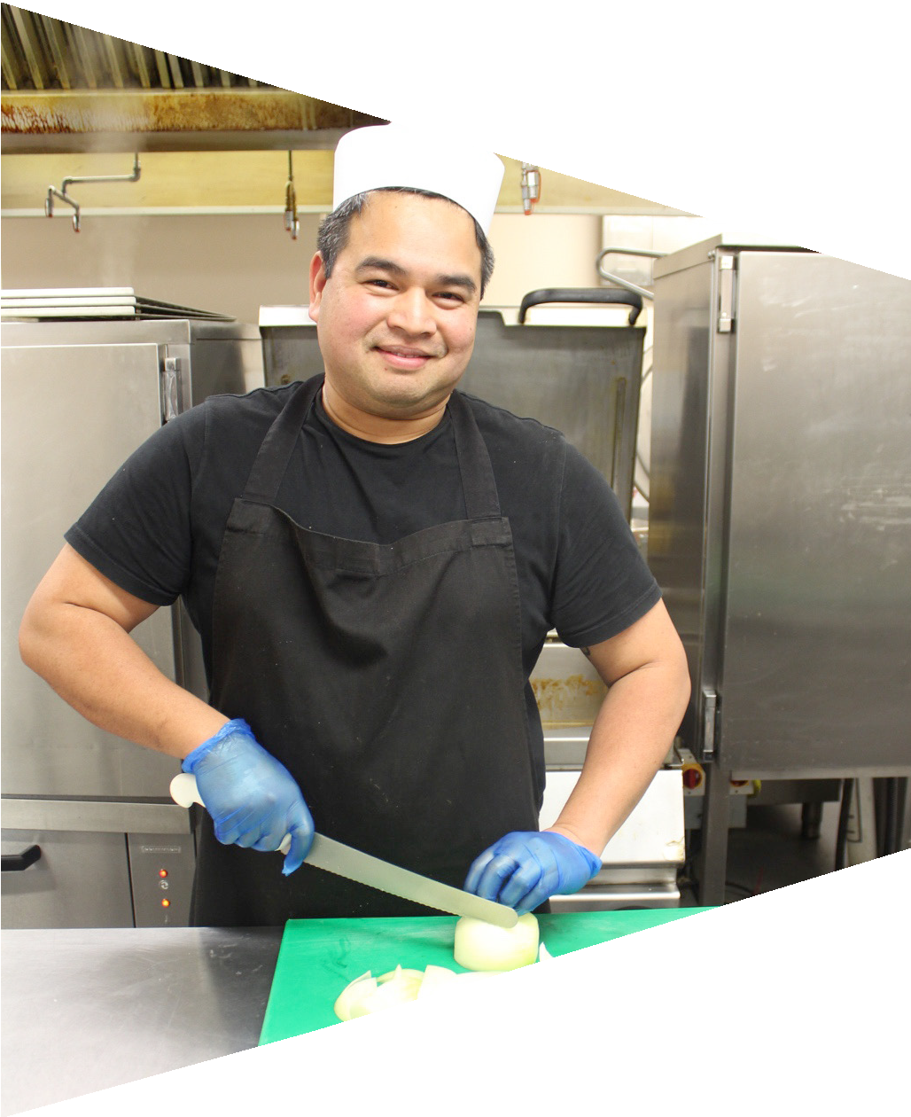
Chef
Chefs are responsible for cooking all the food for NHS patients and making sure it meets patients’ medical and cultural needs.

Slide 8
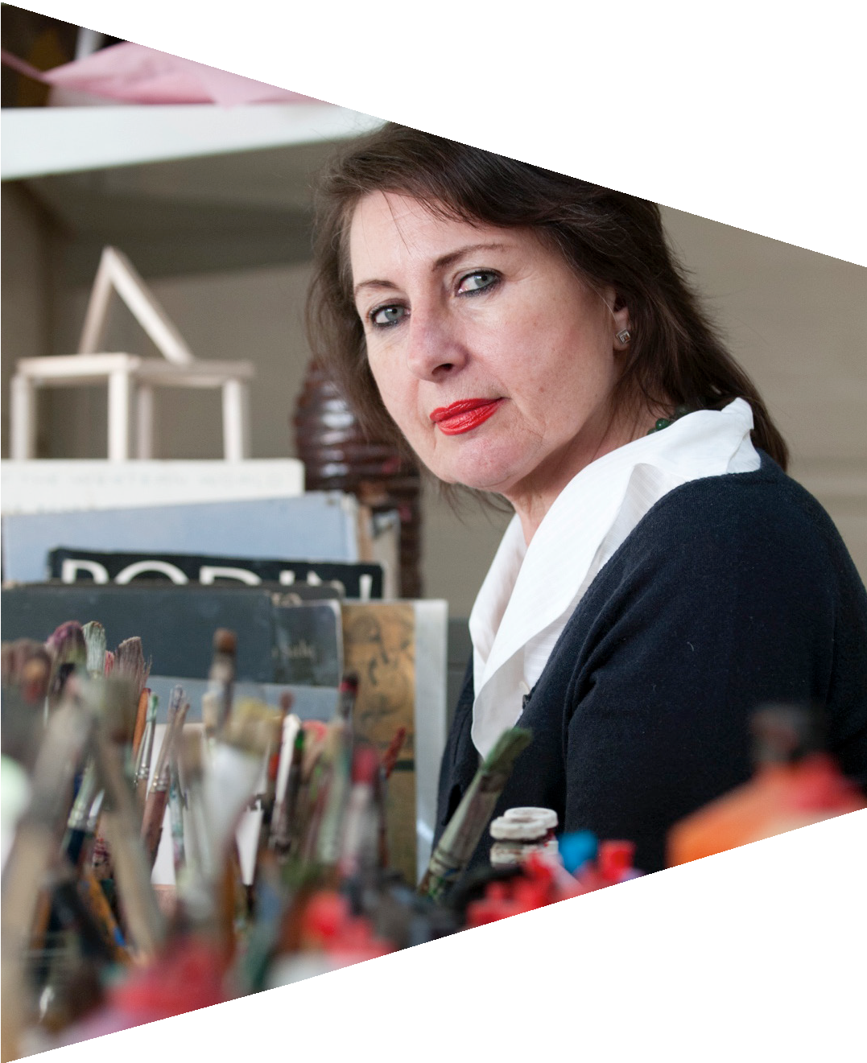
Art therapist
Art therapists help their clients to communicate, to express their
feelings, and to explore their lives and problems through art work.

Slide 9
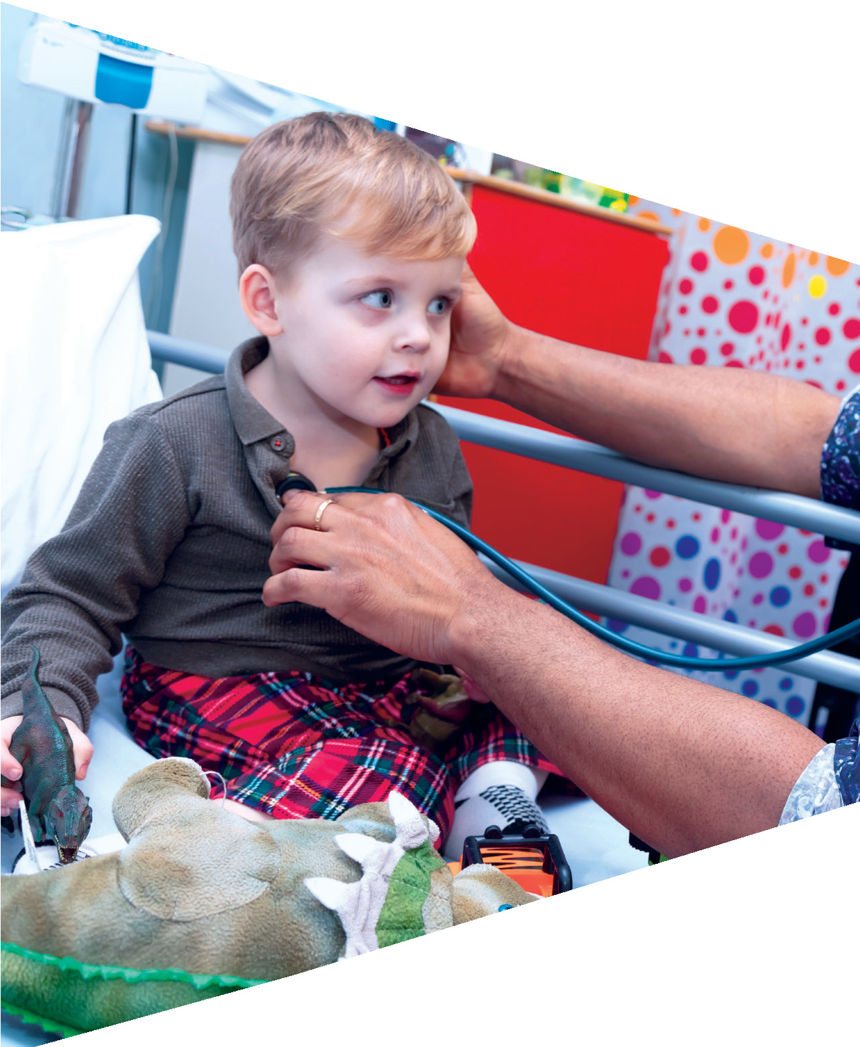
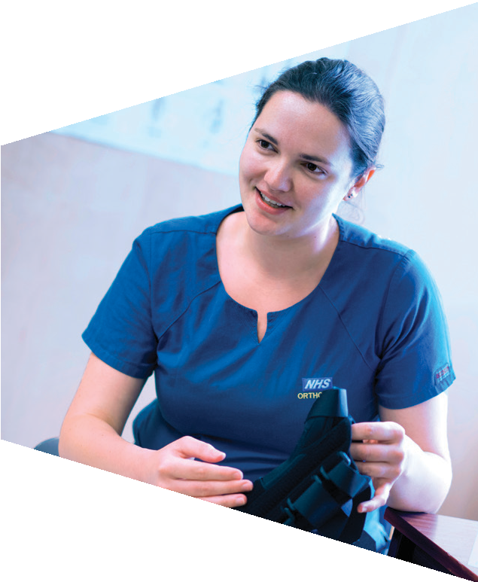
Activity 2: The joy of caring

Slide 10
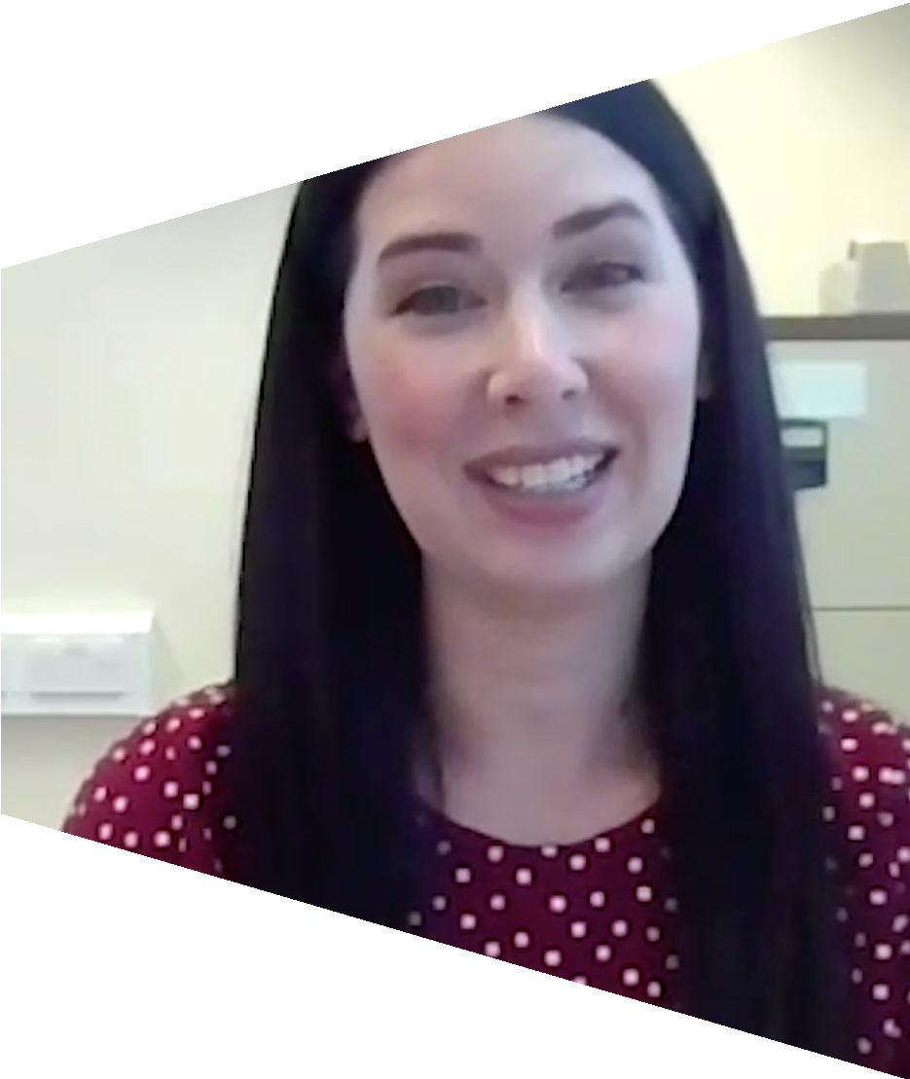
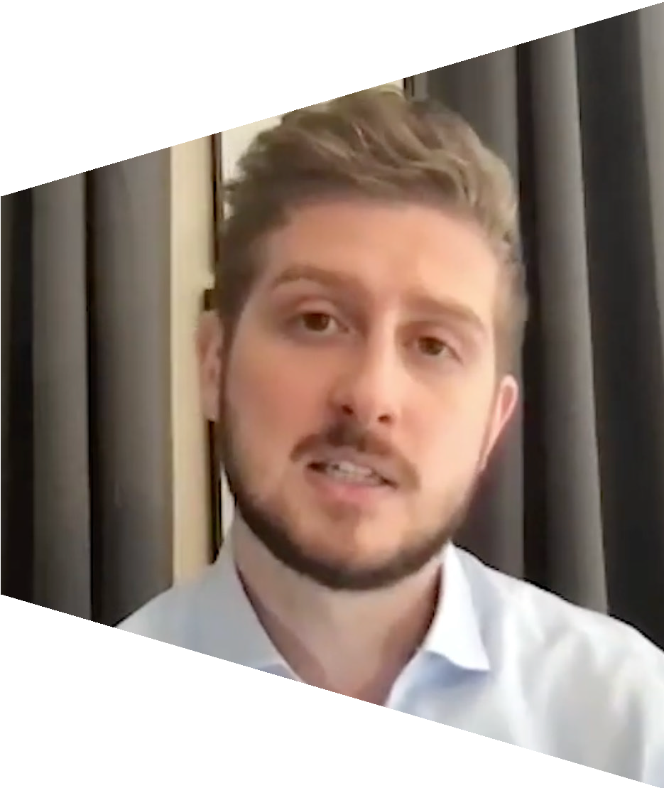
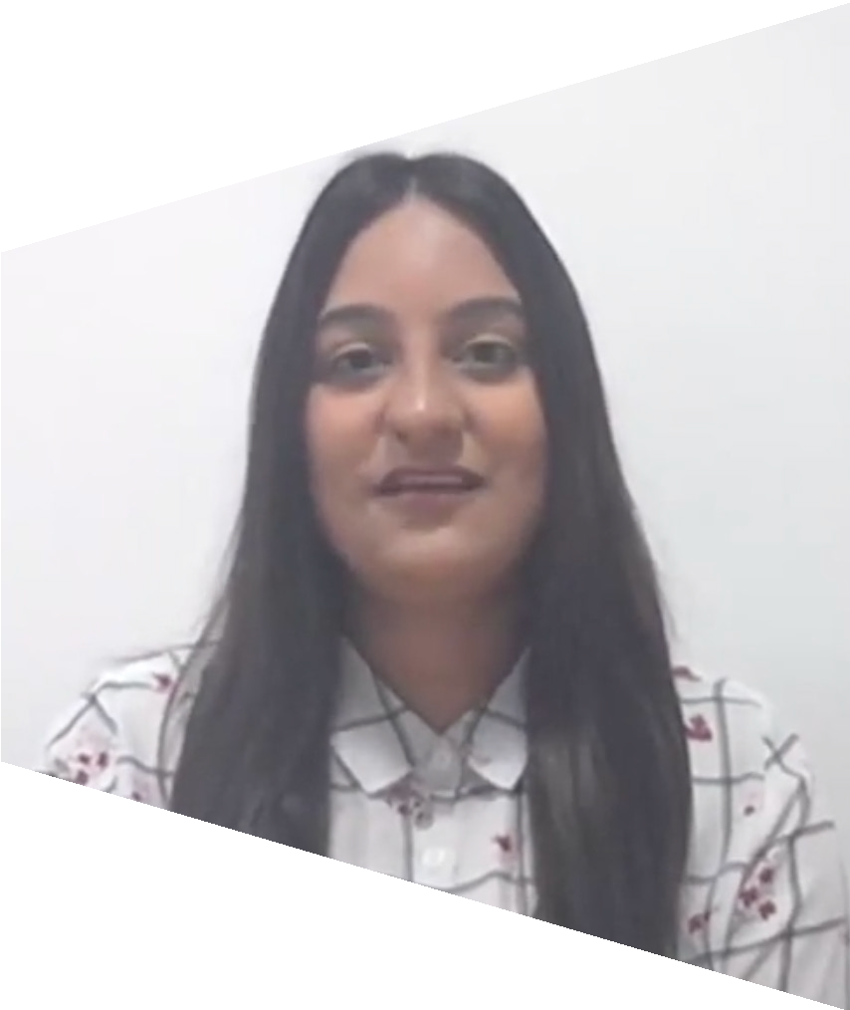
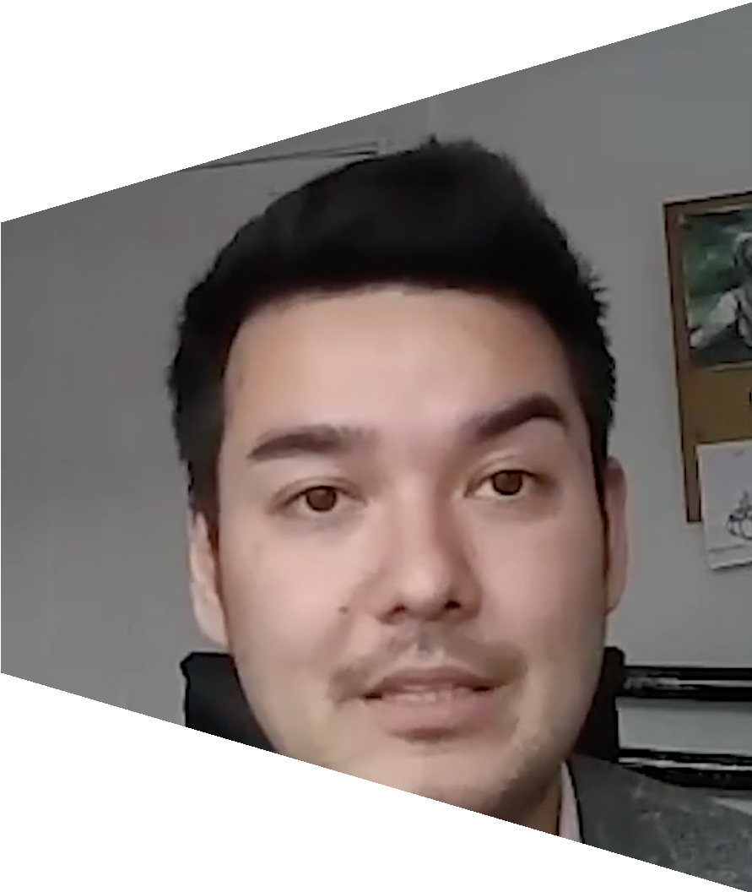
Skills of healthcare professionals
You are going to watch a video.
Using the worksheet, circle any skills that you think describe the people in the video.

Slide 11
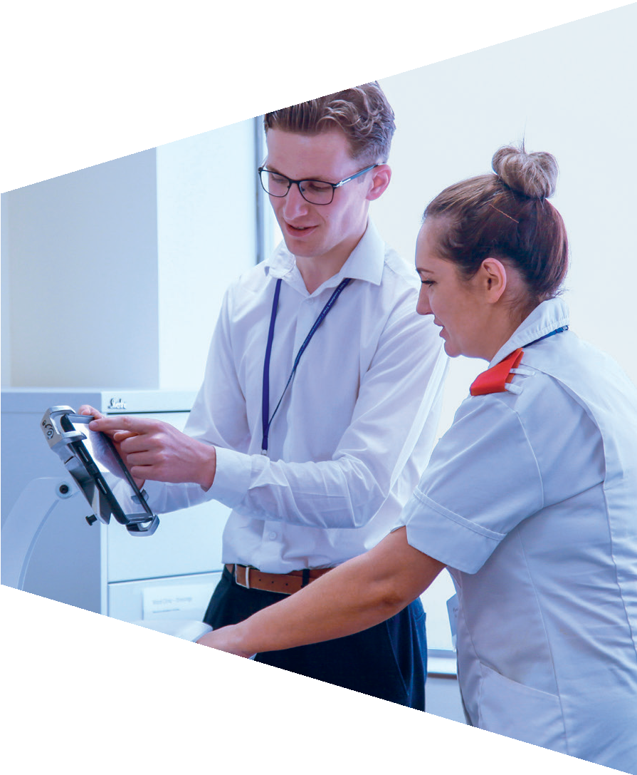
What skills make a good carer?

Slide 12
Good with people
Calm
Professional
Positivity
Good carer
Confidence
Helpful
Problem solving
Good listener
Observation
Trustworthy

Slide 13
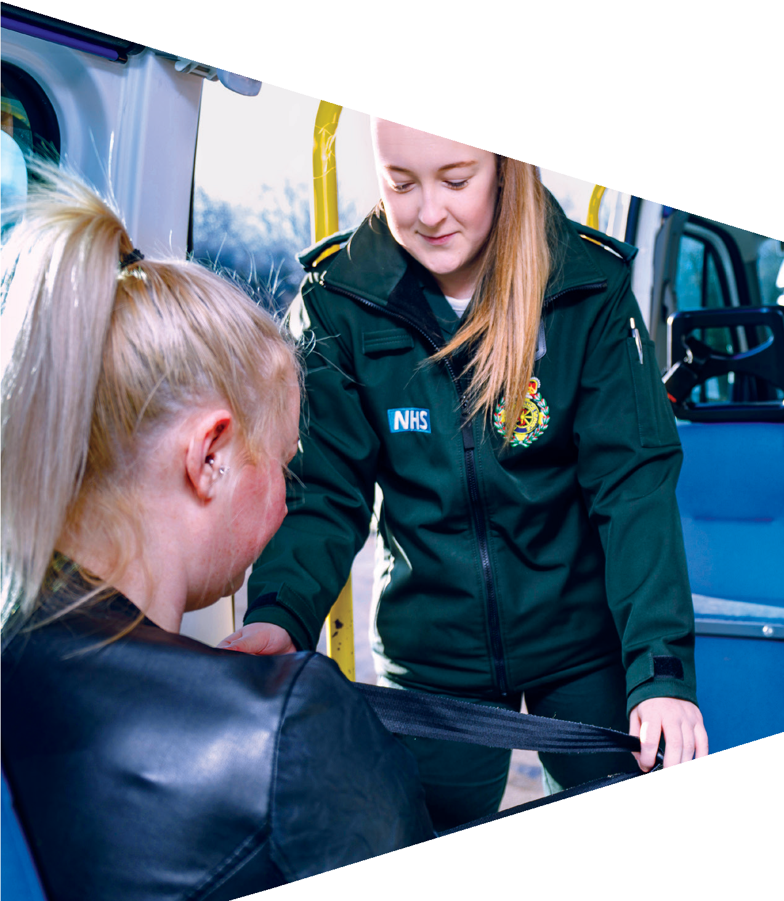
Activity 3: Real people, real carers

Slide 14
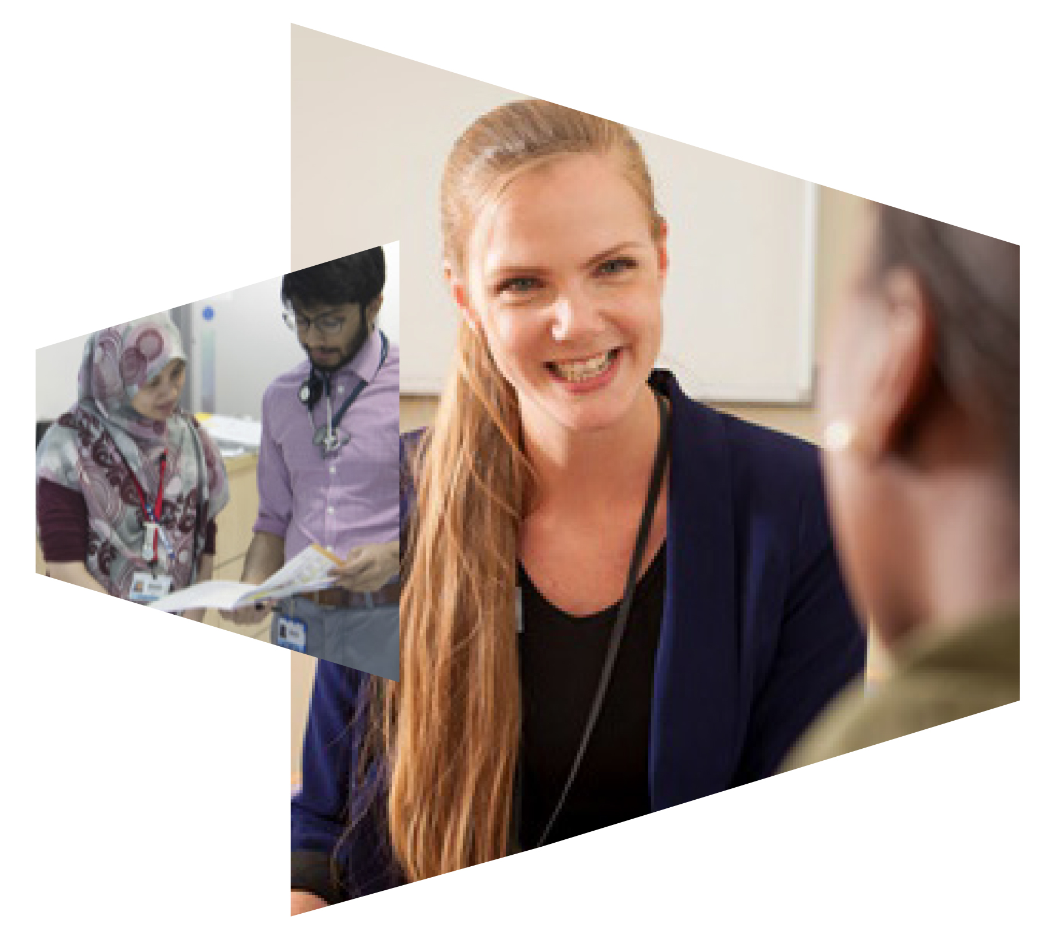
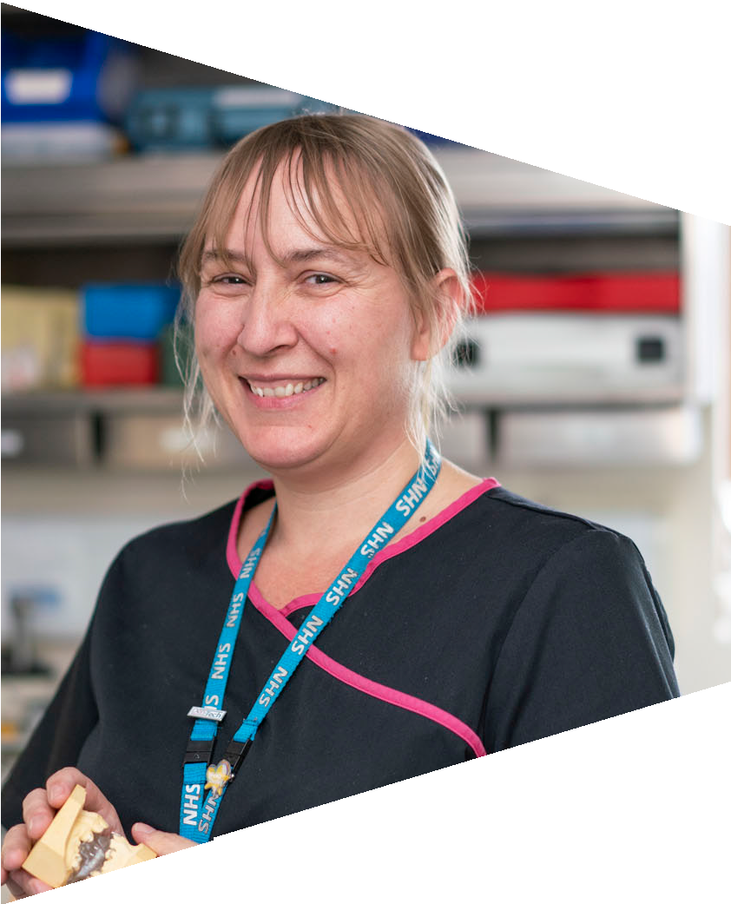
Role-play
Review the cards on the worksheet.
Work in pairs and take it in turns to describe how the professional would respond in that situation.
Consider the person’s skills and discuss what action you think they should take and how they
should act to reassure the patients.
Prepare a role play of one of the scenarios to share with the class.

